Slide 1
Assignment
20 February 2014
Notes:
Guidewire training materials contain Guidewire’s confidential information subject to confidentiality and non-disclosure agreements. You agree to use the information in this manual solely for the purpose of training to implement Guidewire’s software solutions. You also agree not to disclose the information in this manual to third parties or copy this manual without Guidewire’s prior written consent. Guidewire training may only be given by Guidewire employees or certified Guidewire partners under the appropriate agreement with Guidewire.

Slide 2
Lesson objectives
By the end of this lesson, you should be able to:
Identify the assignable objects
Describe how assignment can be done at the group level
Describe how assignment can be done at the user level (where the final owner is chosen by rules)
Describe how assignment can be done at the user level (where the final owner is chosen by a user)
This lesson uses the notes section for additional explanation and information. To view the notes in PowerPoint, choose View→Normal or View→Notes Page. If you choose to print the notes for the lesson, be sure to select “Print hidden slides.”

Slide 3
Lesson outline
Assignment basics
Group assignment
User assignment via rules
User assignment via users

Slide 4


Assignable objects
An assignable object is an object that has work associated to it which must be completed by a user
Five types of assignable objects in the base application:
Claim
Exposure
Service
Matter
Activity
Notes:
Assignment is the act of selecting an owner for an assignable object.
A matter is a set of data pertaining to a single (potential) lawsuit. Matters are discussed in the "Specialized Claims Processes" lesson.
User-defined entities can be configured to be assignable as well. Service Requests are also assignable objects. They are discussed in the “Creating Vendor Service Requests” lesson of this course. Service Requests are assignable in the user interface (using the “Assign” button) starting in ClaimCenter 8.0.1.

Slide 5
The outcome of assignment
Upon completion, assignable objects are assigned to a group and a user in that group
Notes:
For claims and activities, it is possible to assign the object to a temporary location before the final user and group have been selected. (Claims can temporarily be assigned to a "Pending assignments" list, and activities can be assigned to a group queue.) However, these locations are only intermediate points in the assignment process. Eventually, every assignable object is assigned to a group and a user in that group.

Slide 6

When and how does assignment occur?
 | How is new owner chosen?
 | Rule-Based Assignment | Explicit Assignment
Creation of new object
Reassign- ment of Existing object
He gets it.
When is object assigned?
He gets it.
owner 1
owner 2
owner 1
owner 2
Notes:
Assignment occurs:
When an assignable object is created
When the owner (or someone with sufficient permissions) explicitly chooses to reassign an object
In either case, the owner can be:
Specified explicitly
Chosen through assignment rules
In the base application, the owner of an object and the supervisors he or she reports to (directly or indirectly) can reassign an object. In some cases, other users may also have reassignment permission. For example, the owner of the claim can reassign any exposure on the claim, even if the claim owner does not also own the exposure in question. The permissions around who can reassign an object is configurable.
During automated claim setup, the following are assigned:
The claim itself
Any activities created as part of the claim workplan
Any exposures created during claim setup. (Exposures are discussed in the "Exposures" lesson.)

Slide 7
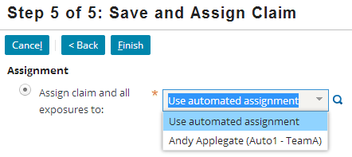


Assigning a new claim: Example
Rules-Based assignment
Explicit assignment
Notes:
The example above shows the assignment of a new claim. This occurs during the second to last step of the full new claim wizard. The user can either search for and select a specific group and/or user (as shown in the "Explicit assignment" screenshot), or the user can specify that automated assignment rules should be used to assign the claim (as shown in the "Rules-Based assignment" screenshot).
If a user specifies only a group, then assignment rules are still used to select a user within that group.

Slide 8
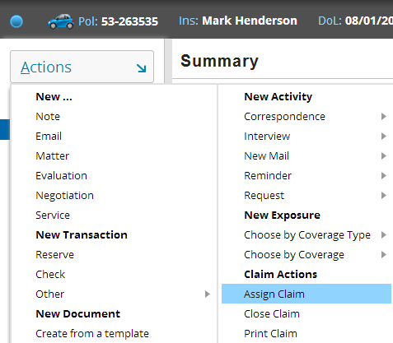
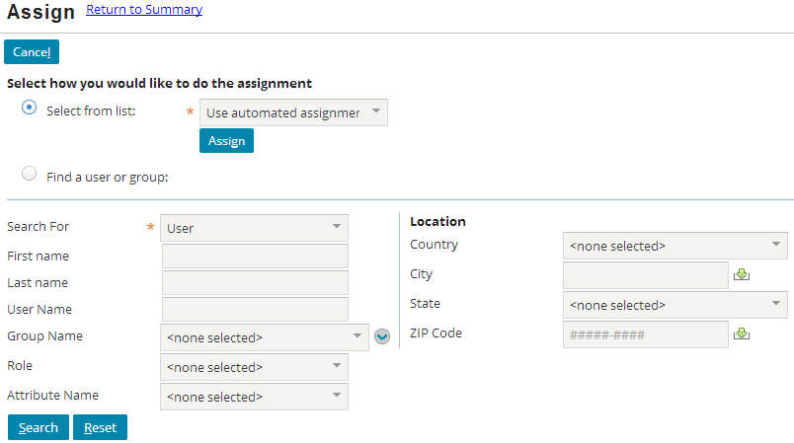
Reassigning an existing claim: Example
Notes:
The example above shows the reassignment of an existing claim. This occurs by selecting the assign claim menu item from the claim's claim Actions menu. The user can either specify that automated assignment rules should be used to reassign the claim, or the user can select a specific group and/or user via the dropdown list or by searching for them.

Slide 9
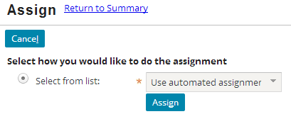
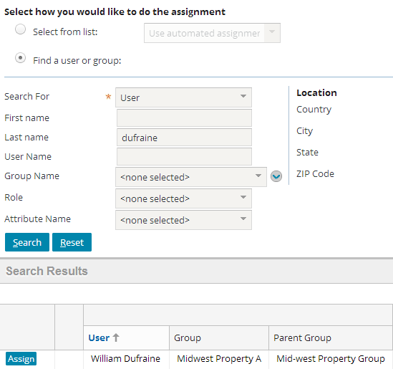
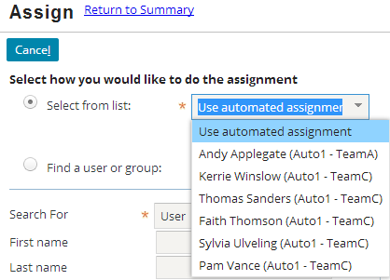
Reassigning an existing claim: Example, cont
Rules-Based
Explicit
Notes:
If a user specifies only a group, then assignment rules are still used to select a user within that group.

Slide 10
Two phases of assignment rules
Peter Beebe
Dana Evans
Western Normal Auto Adjusters
Leroy Martel
Claim 100-00-000027 location: California seg: mid-complexity
Irvin Hickman
Elias Marr
Western Complex Auto Adjusters
Automated assignment typically involves two phases
Group assignment
User assignment (to user within that group)

Slide 11
Lesson outline
Assignment basics
Group assignment
User assignment via rules
User assignment via users

Slide 12
Groups
Western Auto Adjusters
Western Regional Adjusters
Western Fraud Auto Adjusters
A group is a collection of users who share a job function
The top-level group represents entire organization
Except for top-level group, every group has exactly one parent
Notes:
Groups are organized into a hierarchy. A group can contain child groups.
Groups are used to help identify which user to assign work to.
The majority of the functionality tied to users and groups exists to facilitate assignment.
The Administration tab displays an expandable tree view of the group structure on the side bar. This is typically visible only to users with supervisor or administrative permissions. An example of the tree view is shown below (which is visible if you view PowerPoint in Notes view (View > Notes Page)). In the example, Mike Maples is the supervisor for the corresponding expanded group (Western Auto Group). The Western Auto Group’s parent is the Western Regional Claims Center. Two child groups (Auto – Level1, Auto – Level2) are below Western Auto Group.

Slide 13
Users in groups
Peter Beebe
Dana Evans
Western Auto Adjusters
Leroy Martel
"virtual" group
Leroy Martel
Western Regional Adjusters
Irvin Hickman
Western Fraud Auto Adjusters
Irvin Hickman
Elias Marr
Western Complex Auto Adjusters
Notes:
Unlike group-to-group relationships, in which every child group can belong to only a single parent group, user-to-group relationships are many-to-many. A user can belong to multiple groups. (In the example above, both Leroy Martel and Irvin Hickman belong to two groups.) When a user belongs to two or more groups, he or she may get objects assigned to him or her from all of the groups to which they belong. (In the example above, Leroy Martel may get objects assigned to the normal auto group as well as objects assigned to the fraud auto group.)
In a live instance of claimCenter, the majority of the groups reflect the reporting structure of the carrier. (In other words, for most groups, the individuals of the group are all assigned to the same department and all report to the same supervisor.) There are a small number of groups which do not reflect reporting structure, but instead reflect a common job responsibility shared by two or more individuals in different departments. These groups are sometimes referred to as "virtual" groups because they do not represent any aspect of the reporting structure. Virtual groups are created to simplify the assignment of objects which involve similar logic but individuals in different parts of the organization's hierarchy. (In the example above, the "Western Fraud Auto Adjusters" group is a virtual group. It contains two individuals, both of whom belong to other groups. Auto claims which appear to be fraudulent are assigned to this group, regardless of whether they are normal or complex.)

Slide 14
Group attributes related to assignment
Midwest Normal Auto Adjusters
Southeast Medical WC Adjusters
Auto Normal
WC Medical
Type:
Type:
Regions:
Regions:
Notes:
Groups have the following attributes which may be used in assignment rules:
Type
Region(s)
The group type identifies the kind of work the group is responsible for. The region identifies the location in which the group has responsibilities. Together they are used when an object needs to be assigned to a group of a certain type, but there are multiple groups which do that kind of work. (For example, a carrier may have three regions: North, South, and Central. Each region has four groups, Auto Normal, Auto Complex, WC Medical, and WC Liability. A medical workers' comp claim in Tennessee needs to be assigned to the WC Medical group in the south region. The group type is used to determine which groups in the South region are WC Medical groups.)
Users assigned to a group are assumed to be capable of handling the kind of work the group does, but there is no system functionality to enforce this. In other words, there is no "WC Medical" attribute given to users who are added to a WC Medical group, and there is no WC Medical attribute that a user must have in order to be allowed to be assigned to a WC Medical group. ClaimCenter simply assumes that, unless additional logic states otherwise, every member of a group is qualified to own work assigned to that group.
In addition to type and region, there is a third way in which group-level assignment can be done. An object assigned to a parent group can be assigned using "round robin"ing to one of the child groups. However, this approach to group-level assignment is rarely used. (Round robin assignment is frequently used for user-level assignment.)

Slide 15
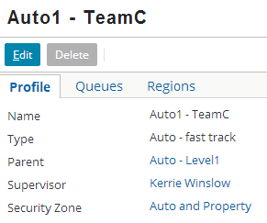
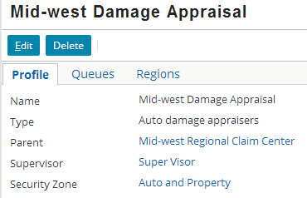
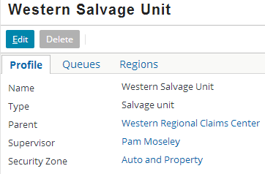
Group type
Group type identifies function of group or job it performs

Slide 16
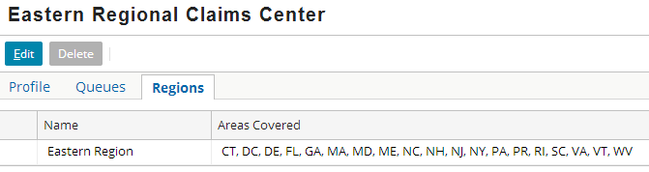
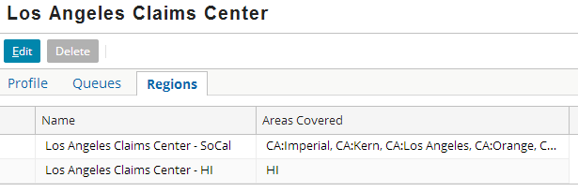
Groups and Regions
Eastern (US) States
Southern California & Hawaii
A region is a geographic region, which can be based on locale-specific geographic entities such as cities or postal codes
Notes:
The type of region to be associated with groups is configured according to the given locale.
In the base application for North America (US, Canada and Mexico), regions can be based on states, provinces, counties, cities, postal or zip codes.

Slide 17
Group assignment using type and region
if loss type = "auto" and segment is "fast track" then assign to group of type "fast track auto" where region = loss location region
TYPE
fast track auto
normal auto
workers' comp
fast track auto west
normal auto west
workers' comp west
west
fast track auto central
normal auto central
workers' comp central
REGION
central
fast track auto east
normal auto east
workers' comp east
east
Notes:
The diagram above represents assignment logic that makes use of group type and region.
In this example, the carrier has nine groups. There are three regions (west, central, and east), and three groups in each region. Within a region, there is one group of type "fast track auto" (for auto claims that have been segmented as "fast track"), one group of type "normal auto" (for auto claims that have not been segmented as "fast track"), and one group of type "workers' comp (for workers' comp claims, regardless of how they have been segmented).
The assignment logic states that if a claim is an auto claim and has been segmented as fast track, then it should be assigned to a group with type "fast track auto" and whose region matches where the loss location is. These two criteria uniquely identify a single group for the claim to be assigned to.

Slide 18
Assignment cannot stop at the group level
Peter Beebe
Dana Evans
Midwest Normal Auto Adjusters
Leroy Martel
Claim 100-00-000027 location: Missouri seg: mid-complexity
Irvin Hickman
Elias Marr
Midwest Complex Auto Adjusters
Objects are not considered assigned until they are assigned to both group and user within that group
ClaimCenter has assignment capabilities that handle rare cases where objects are not assigned to groups and/or users
Notes:
If an object is assigned to a group without being assigned to a user (or potentially a queue, in the case of an Activity), then ClaimCenter assigns it to the Group Supervisor. The object must then be manually reassigned.
If an object is not assigned to a group, then ClaimCenter assigns it to a “dummy” user called Default Owner and the root group of the hierarchy. The "Default Owner" is a dummy user used for objects which "fail" group assignment. You cannot log on as Default Owner, and there is typically extra overhead in identifying items assigned to Default Owner and reassigning them to a real user.
Ideally, the business logic for assignment should be written and configured such that assignable objects never fail to get assigned to a group and user.

Slide 19
Lesson outline
Assignment basics
Group assignment
User assignment via rules
User assignment via users

Slide 20
Who decides which user within the group gets the object?
Assignment rules
Another user (typically a supervisor)
The owner himself (when he/she takes ownership of an unassigned object)
Peter Beebe
Peter Beebe
Peter Beebe
Notes:
This topic within this lesson focuses on the options for assignment when it is done by the rules engine. The next topic of this lesson focuses on the options for assignment when it is done by a user.
All assignable objects (in base ClaimCenter, this includes claims, exposures, activities, services and matters) can be assigned to a specific user through the rules engine. User assignment through a supervisor typically involves only claims but may include any assignable object. User assignment through an unassigned object queue involves only activities.

Slide 21
User attributes related to rule assignment
Peter Beebe
Leroy Martel
Groups & Load Factors:
MW Normal Auto Adjust. (100)
Groups & Load Factors:
MW Normal Auto Adjust. (50)
MW Fraud Auto Adjust. (100)
Español
Attributes:
Attributes: (none)
Regions:
Regions:
Notes:
Users have the following attributes which may be used in assignment rules
Group membership and load factor
Attributes
Region(s)
Recall that a user can be assigned to one or more groups.
Also recall that users assigned to a group are assumed to be capable of handling the kind of work the group does, but there is no system functionality to enforce this. In other words, there is no "WC Medical" attribute given to users who are added to a WC Medical group, and there is no WC Medical attribute that a user must have in order to be allowed to be assigned to a WC Medical group. ClaimCenter simply assumes that, unless additional logic states otherwise, every member of a group is qualified to own work assigned to that group.
Like a group, a user can be associated to one or more geographic regions. An object can be assigned to a user in a particular region. If there are multiple users with the desired attribute(s), the object is round-robined among those users.
User regions are often used to identify a user works within a specific sub-region of the group's region. In the example above, Peter Beebe is a member of the US-MW (midwest) Normal Auto Adjusters group. However, he does not work on claims in the entire midwest region. He works on claims specific to Missouri. All normal auto midwest claims are routed to the US-MW Normal Auto Adjusters group, but Peter Beebe should be considered only when the claim is a normal auto claims specific to Missouri. Setting a region at the user level specifies this.

Slide 22
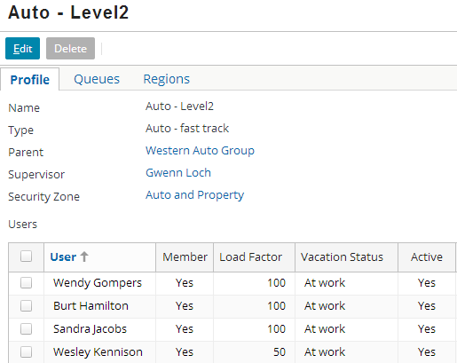
Group assignment and load factors
Objects assigned to a group can be assigned using "round robin"
Load factor weights how often objects are round-robined to that user when assigning across entire group
Notes:
"Round robin" is a method for assigning an objects to members of a set in a cyclical fashion. When this approach is used, the first member of the set (such as the first user of a given group) is assigned the first object, the second member of the set (such as the second user of a given group) is assigned the second object, and so on. When all of the members have been assigned an object, the cycle repeats with the first member. (For example, if a group had seven users, then the first user is assigned the eighth object, the second user is assigned the ninth object, and so on.) Round robin can be used to distribute objects among users in a given group as well as to distribute objects among child groups in a given parent group.
The primary purpose of load factor is to describe the general amount of work that should be assigned to an individual in a group compared to the other members of the group. In the screenshot above, Gwenn Kennedy would receive half the workload that Scott Arthur, Isabel Harkin, and Terence Johnson receive from the assignment engine (from claims assigned to this group only.) Load factors have no meaning when comparing users across groups or even a subset of a single group.
Load factor is typically a static value assigned by the manager. However, there have been some instances of ClaimCenter in which the rules have been configured to make the load factor values more dynamic.

Slide 23
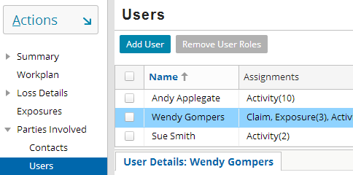
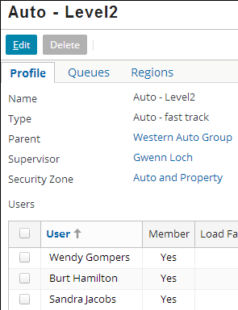
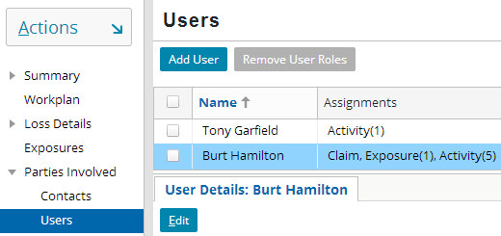
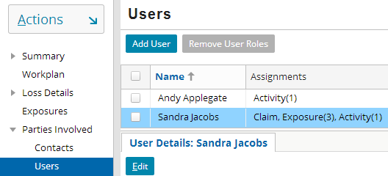
Group assignment with round robin: Example
Claim 1
Claim 2
Claim 3
Notes:
In the example above, three claims are assigned to the LA Auto Adjusters group. Notice that each claim is assigned to the next user in the list. Though the order is not significant, the same criteria are used so that the total assignments are balanced per the load factors.

Slide 24
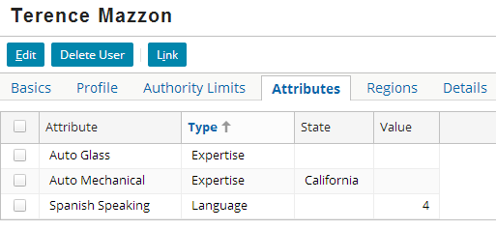
User attributes
Objects can be assigned to a user with a particular attribute (in a particular state and/or of a particular level)
If multiple users have the desired attribute(s), objects are round-robined among a virtual group consisting of those users
Load factors are ignored because they are only meaningful across an entire single group
Notes:
The attribute can be limited to a single state. The assignment rules can then search for a user with the given attribute in a given state (such as "find a user with auto mechanical expertise in California).
The attribute can have a value, or level of qualification. The assignment rules can then search for a user with the given attribute at the given level (such as "find a user who is a Spanish speaker at level 4 or higher.)
Ideally, whenever there is a user assignment based on attributes, there is more than one user with the required attributes. ClaimCenter automatically uses round robining with user attribute assignment. (For example, if there are 27 users with the "Spanish Speaking" attribute, then the first object goes to the first Spanish Speaking user, the second object goes to the second user, and so on.)

Slide 25
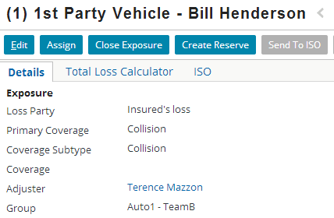
User attribute (with round robin): Example
if insured's language is Spanish AND coverage subtype is glass damage
then assign to user with Auto Glass expertise and Spanish Speaker
Notes:
Recall that ClaimCenter automatically uses round robining with user attribute assignment. Load factors are ignored because they are only meaningful across an entire single group.

Slide 26
Choosing a user for assignment: Weighted Workload
Weighted workload is an alternative to round robin:
Round robin assigns work proportionately according to a statically-defined weight factor
Weighted workload assigns work to user in group with least complex workload
If assignment via round robin …
If assignment via weighted workload …
Who should I be assigned to?
User whose turn is next
User with lightest workload
Notes:
Round robin assigns objects in a cyclical fashion without regard to the quantity or complexity of a user's current workload. When using this strategy, each user will ultimately have the same number of objects assigned to them, but the overall complexity of the workload could vary. Additionally, the number of active objects for users in a round robin could vary widely if, for some period of time, one user's objects happen to close significantly more quickly than another's.
Weighted workload assigns objects based on complexity of each user's existing workload without regard to the number of objects each user owns. When using this strategy, each user will ultimately have the same overall complexity of workload, but the actual number of objects could vary.

Slide 27
Balancing adjuster workload
Who should I be assigned to?
Weighted workload is a mechanism for balancing adjuster workload by assigning claims and exposures based, in part, on their complexity
When this feature is enabled, every claim and exposure is assigned an integer value representing its weight
New claims and exposures are assigned to the user whose workload has the least weight
48
Alice
30
Bob
62
Carol
Notes:
In the diagram above, there are three users: Alice, Bob, and Carol. Each user has a workload with a different weight. That weight is not simply a measure of the number of claims and exposures assigned to that adjuster but a measure of the collective difficulty of those claims and exposures. In this case, Carol has the fewest claims but the heaviest workload. The next new claim is assigned to the user with the lightest workload, which in this case is Bob.
When assigning a claim or exposure, the weight of the object to be assigned is not a factor. Only the weight of each candidate user’s workload is considered.
Weighted workload assignment can be used with any assignable entity: Claim, Exposure, Matter, or Activity. The base application only supports the two most common cases: Claim and Exposure. It is possible to configure the application to support any other desired assignable. The full details on how to do this are beyond the scope of this lesson but some basic information is provided.

Slide 28
Key tasks in weighted workload assignment
Select user with lowest workload weight for assignment
Determine the weight of object to be assigned
Update each user’s current workload weight
Andy
Sue
40
38
28
8
12
10
6
8
6
20
8
Notes:
Weighted workload assignment requires keeping track of the workload weight of each user. That means each new claim, exposure or other assignable needs to be given an appropriate weight so that the weight can be added to the assigned user’s workload weight. Maintaining accurate user workload weights allows the next assignable to go to the eligible user with the lightest load.
The weight of objects to be assigned is important in determining the total workload weight of the assigned user. This weight is not a factor in determining who gets the next assigned claim or exposure.
For more on this topic, consult the ClaimCenter 7.0 – 8.0 New Configuration Features training course.

Slide 29
Lesson outline
Assignment basics
Group assignment
User assignment via rules
User assignment via users

Slide 30
Who decides which user within the group gets the object?
Assignment rules
Another user (typically a supervisor)
The owner himself (when he/she takes ownership of an unassigned object)
Peter Beebe
Peter Beebe
Peter Beebe
Notes:
There are two situations where the owner of an assignable objects is sometimes chosen by a user (as opposed to assignment rules)
Assignable objects (typically claims) are sometimes put into a pending assignment state until a user (typically a group supervisor) assigns the object.
Activities are sometimes assigned to a group queue, and users in the group can take ownership of the activities.
This topic within this lesson focuses on the options for assignment when it is done by a user. The previous topic of this lesson focused on the options for assignment when it is done by the rules engine.
All assignable objects (in base ClaimCenter, this includes claims, exposures, activities, and matters) can be assigned to a specific user through the rules engine. User assignment through a supervisor typically involves only claims but may include any assignable object. User assignment through an unassigned object queue involves only activities.

Slide 31
"Pending assignment" objects
Terence Johnson
Scott Arthur
Los Angeles Auto Adjusters Pending assignments
Wesley Roosevelt
Assignable objects can be marked "pending assignment“
“Assign object” activities are created and appear only on a special list visible only to the supervisor of the group
The supervisor is responsible for manually assigning the object to a member of the group
Notes:
Pending assignment is typically used when you want the final assignment to be based upon human judgment.

Slide 32
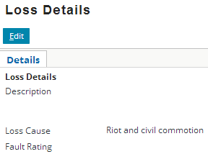
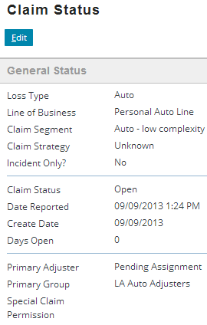
Pending assignment: Example
if loss cause is riot and civil commotion then mark claim as pending assignment
Notes:
In the example above, all claims with a loss cause of "riot and civil commotion" are marked as pending assignment for the supervisor of the Los Angeles Auto Adjusters group, who happens to be Wesley Roosevelt. He is then responsible for manually assigning the claim to another user in the group.

Slide 33
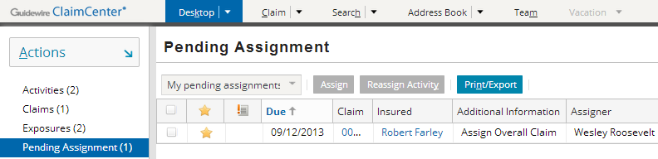
The pending assignment list
Typically, pending assignment is visible only to group supervisors
Lists “assign object” activities for objects to be manually assigned
Notes:
In the example above, the user is Wesley Roosevelt. From his desktop, he can see there is one activity in the pending assignment list, for the Robert Farley claim. From this list, he can access the claim and/or assign the claim manually as appropriate.

Slide 34
Activity queues
Western Salvage Unit
Vehicle salvage opportunity
Lucas Fleming
Vehicle salvage opportunity
Salvage Actions
A queue is a repository associated to a group which contains activities that have been assigned to the group but not yet assigned to any user within that group
Users within the group can take ownership of activities in the queue
Notes:
Unlike groups and users, which can own any type of assignable object, queues can contain only activities.

Slide 35
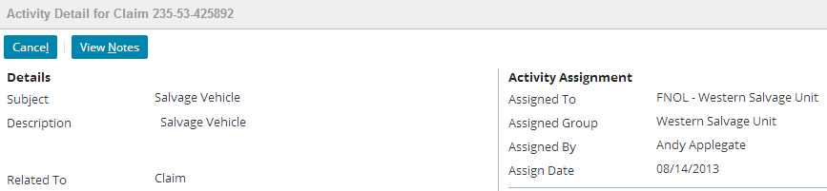
Queue assignment: Example
if activity is a "Vehicle salvage opportunity" activity
then assign to Salvage queue for group to which claim is assigned
Notes:
In the example above, all activities which are created from the Vehicle Salvage Opportunity activity pattern are assigned to the Salvage queue for the group to which the claim is assigned. The claim in question is assigned to the Western Salvage Unit group. Therefore, the activity is assigned to the Salvage Actions queue for that group.

Slide 36
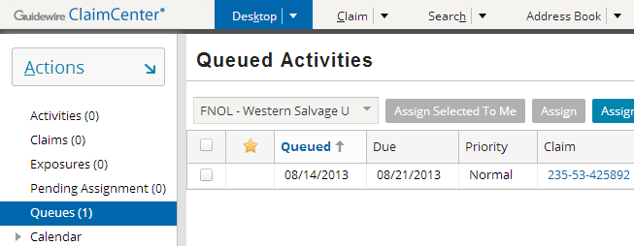
Activities in a queue: Example
From the Desktop, users can
View activity queues accessible to them
Take ownership an activity in each queue
Typically the “next” activity in the queue
Sometimes user can choose an activity from the queue
Notes:
Users can view objects assigned to queues they have access to by clicking the Queues menu link on the Desktop tab. The queues the user has access to are listed in the dropdown at the top of the list. Once the user selects a given queue, all objects in the queue appear in the list. The user can then take ownership of the next activity in the queue by clicking the "Assign Next In Queue To Me" button. Sometimes there will be an “Assign Selected to Me” button if ClaimCenter has been configured to allow it.

Slide 37
Assignment summary
Objects assigned to group first based on:
Group type, and/or
Group region
Then, objects assigned to user within group based on:
Round robining within a group, or
Round robin among users with given attribute(s), or
Round robin among users in a given region, or
Selecting user with lowest load factor
Manual assignment of claims by a supervisor via pending assignment list, or
Manually taking ownership of activities by users via queue
Auto Normal
Español

Slide 38
Lesson objectives
You should now be able to:
Define the assignable objects
Describe how assignment can be done at the group level
Describe how assignment can be done at the user level (where the final owner is chosen by rules)
Describe how assignment can be done at the user level (where the final owner is chosen by a user)

Slide 39
Review questions
From a business standpoint, what determines whether a type of object is assignable or not?
When assignment is complete, what is an assignable object assigned to?
When an object is first created, is it assigned by rules or explicitly by the creator?
Identify if the following is a group-level approach to assignment, a user-level approach, or both:
Type (such as "Workers' Comp")
Region
Attribute (such as "Spanish speaker")
Assignment via activity queue
Notes:
Answers
1. A type of object is assignable if there is some sort of work that needs to be done and a user must be assigned to the object to ensure that it is done.
2. An assignable object is assigned to a user and a group.
3. It depends. The user can choose either approach.
4. a) Group
b) Both
c) User
d) User (activities in an activity queue have been assigned to a group, but not to a user in that group)

Slide 40
Notices
Copyright © 2001-2014 Guidewire Software, Inc. All rights reserved.
Guidewire, Guidewire Software, Guidewire ClaimCenter, Guidewire PolicyCenter, Guidewire BillingCenter, Guidewire Reinsurance Management, Guidewire ContactManager, Guidewire Vendor Data Management, Guidewire Client Data Management, Guidewire Rating Management, Guidewire InsuranceSuite, Guidewire ContactCenter, Guidewire Studio, Guidewire Product Designer, Guidewire Live, Guidewire DataHub, Guidewire InfoCenter, Guidewire Standard Reporting, Guidewire ExampleCenter, Guidewire Account Manager Portal, Guidewire Claim Portal, Guidewire Policyholder Portal, ClaimCenter, BillingCenter, PolicyCenter, InsuranceSuite, Gosu, Deliver Insurance Your Way, and the Guidewire logo are trademarks, service marks, or registered trademarks of Guidewire Software, Inc. in the United States and/or other countries.
All other trademarks are the property of their respective owners.
This material is confidential and proprietary to Guidewire and subject to the confidentiality terms in the applicable license agreement and/or separate nondisclosure agreement.
This file and the contents herein are the property of Guidewire Software, Inc. Use of this course material is restricted to students officially registered in this specific Guidewire-instructed course, or for other use expressly authorized by Guidewire. Replication or distribution of this course material in electronic, paper, or other format is prohibited without express permission from Guidewire.
Guidewire products are protected by one or more United States patents.

